Slide 1
Introduction to
Google Drive
Jump Start 2014: Paul Kaskovich

Slide 2
About Me: Paul Kaskovich
-Digital Learning Coach
-Teaching background: 7th and 8th grade Social Studies, Language Arts and Literature
-Obtaining Masters in Ed. Technology
-Two years experience being completely 1:1 (students took materials home)

Slide 3
Helpful Website
http://d124technology.weebly.com/
-Instructions for everything I show today
-Other helpful links and resources
-Constantly updated

Slide 4
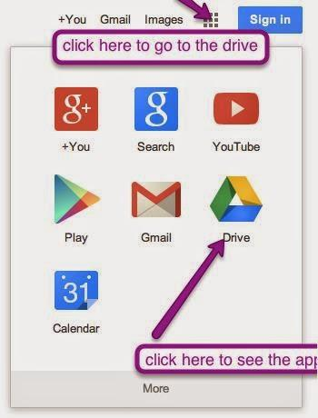
Google Drive: Your Basics
-Now that every student will have an email account through google, Google Drive is an easy way to enhance your lessons with technology & SAVE YOU TIME!
-Sign in at google.com
-Find “the waffle”

Slide 5
Student Usernames/Passwords
- FirstinitialLastname@d124.org
Example: Paul Kaskovich
Username: pkaskovich@d124.org
Example: Maria Smith-Jones
Username: msmithjones@d124.org
*You may run into a duplicate name. If that is the case, try the first two initials of the first name.
Example: Bob Johnson and Betty Johnson
Try this username: bojohnson@d124.org and bejohnson@d124.org

Slide 6
Student Usernames/Passwords
-Student passwords are the students’ Powerschool ID #s.
*We are working on getting a list of usernames and passwords for you to have digital and paper copies.

Slide 7
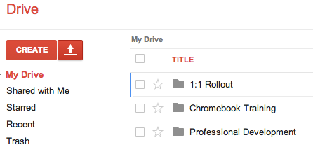
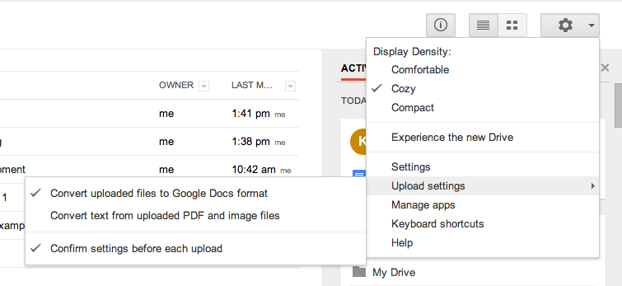
Uploading files
-Digital documents can be uploaded to your Google Drive so that you can edit, revise, and share things you have already done.
-Check your uploading settings to make sure your files will convert
-Find either the red arrow, or simply drag files (or entire folders) into the drive.

Slide 8
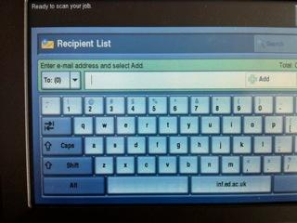
If you have a document on paper...
-You can still upload it onto your Google Drive. However, it will be a .pdf file, meaning that you can view it but not change/revise it.
1. Email yourself the document from a Xerox copier (see picture)
2. Find the email (from Xerox-- if you don’t see it check your spam/trash)
3. Drag it into your Google Drive
Type your email address into recipient list

Slide 9
Organization
-Before the school year, spend some time organizing your Google Drive
-Create folders
-Look at stuff from last year (delete or put into a folder)
-Organize any new items that you upload

Slide 10
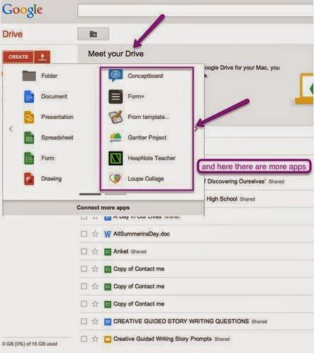
Google Drive: Your Basics
-The Create tab allows you to create a variety of documents.
-Where it says “Connect more apps”-- that is where you can (or have your students) download any apps you would like them to use.
-These apps are only presentation tools. You can download any other apps (games, tools, etc. online)-- there are over 65,000 educational apps. (and most are free!)

Slide 11
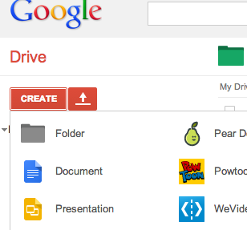
Creating a Google Document
-It functions just like Microsoft Word
-What makes it better? Collaboration.
-Let’s try it!

Slide 12
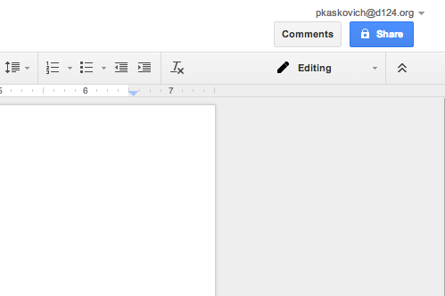
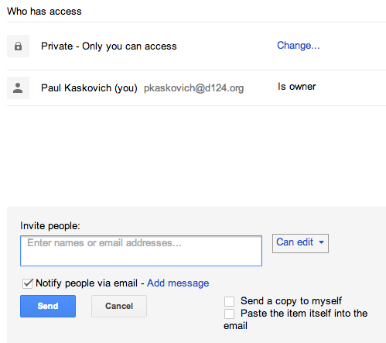
Sharing
Collaborate with..
Teachers (to monitor work, make suggestions, comments, edit)
Other students (group work, projects-- no need to share a computer)
-Invite people by typing their name
-If you have many students sharing with you, have the students uncheck the notify box so you don’t get
overloaded with
emails!

Slide 13
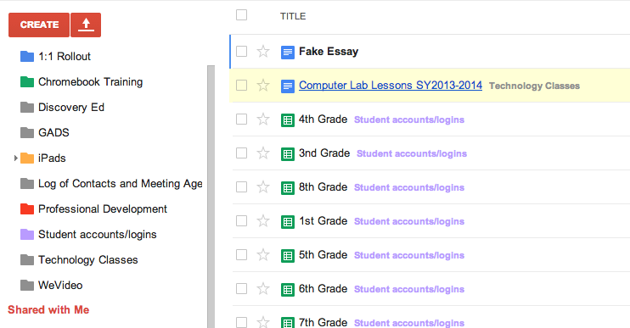
“Shared with Me”
-Anytime something is shared with you, it will automatically go in your “Shared with Me” files.
-Sort them in a folder so you can find everything easily
-Anytime there is a revision to an item, it will appear in a bold font

Slide 14
Google Presentations
-You are looking at one! It can be shared, work can be collaborated, powerpoint files that you have already made can be uploaded and shared with students.
-Take a minute to explore the presentation tool.

Slide 15
Google Forms
What can they be used for?
-Tests/Quizzes -- can be graded instantly with Flubaroo
-Formative Assessments: Did your students meet your daily objective(s)?
-Get an idea of background knowledge
-I used them everyday as a “bell ringer”
-Parent contact information
-Submitting homework/projects

Slide 16
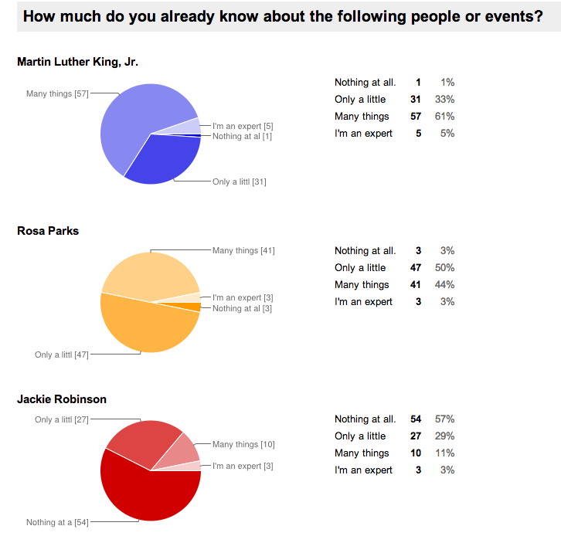
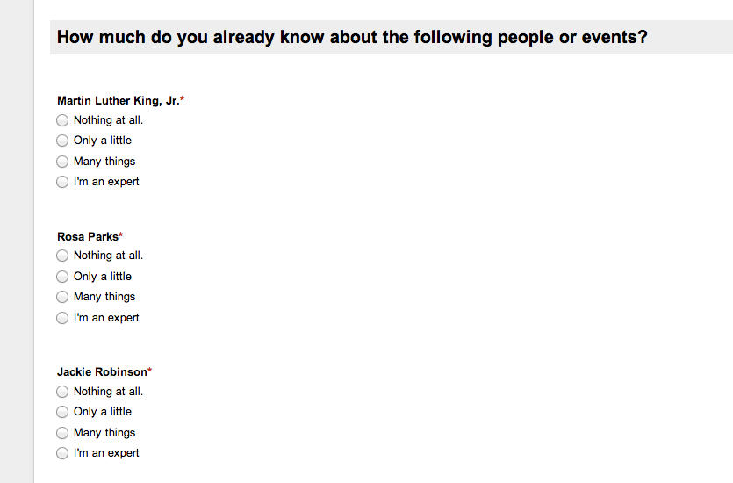
Example:

Slide 17
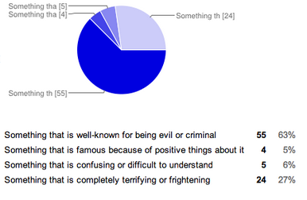
Assessment Tool: Let’s try it!

Slide 18
Let’s try it!
Helpful hints for grading with Flubaroo
-In order to send a grade to your students with Flubaroo, you must check the box at the top that says “Require Evergreen Park Schools D124 login to view the form”
-Any text response is case sensitive. If your student makes a spelling error, it will be marked wrong
-After hitting send form, and choosing how to send it, allow Google to open another spreadsheet for your responses!
-You must also take the quiz so that there is an answer key. Make sure your answers are correct!

Slide 19
In order to get pie charts and graphs:
-Send your form in a link to at least 2 people sitting around you.
-Answer some answers wrong, just to see the data.
-In the response spreadsheet: Hit “Form” then “Show summary of responses” to view the data from your recipients.

Slide 20
Let’s try grading with Flubaroo
-In the “Responses” Spreadsheet: Click “Add-ons” then “Get Add-ons”
-Search for Flubaroo
-Once you have added Flubaroo, go back to “Add-Ons,” “Flubaroo,” and “Grade Assignment”
-Follow the instructions to change how many points each item will be (or skip grading a particular item)
-Choose your submission as the answer key

Slide 21
Using Google Forms as a Dropbox
-Allows you to Collect assignments in one place
-Simple organization of student work.
-Allows for collaboration and feedback on an assignment
-No need to take a bunch of paper home!
Here is a link for step by step instructions. Let’s try it!

Slide 22
Submitting an Assignment in Google Forms
First, find a partner (if there are uneven numbers, get in a group of 3) and do the following tasks:
Partner #2: The Teacher
1. Create a Google Form entitled “Period 5: FAKE Assignment Dropbox”
2.Create 4 “text” questions:
-First name?
-Last name?
-Class period?
-Assignment URL
3. Click “Send the Form”
4. Highlight and copy the link to share. Click “Done”
Partner #1: The Student
1. Create a Google Doc and title it “FAKE Assignment: Your name”
2. Type in a random sentence into your document.
3. Click the “Share” tab in the right corner. Under “Who Has Access” it should be set to Private. Click “Change”
4. Check the box that says “Anyone with the Link”

